Slide 1
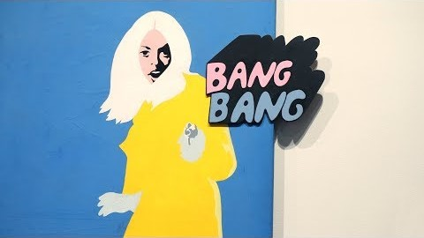
Pop América
2019 Exhibition
Pop Art was global, and it was political

Slide 2
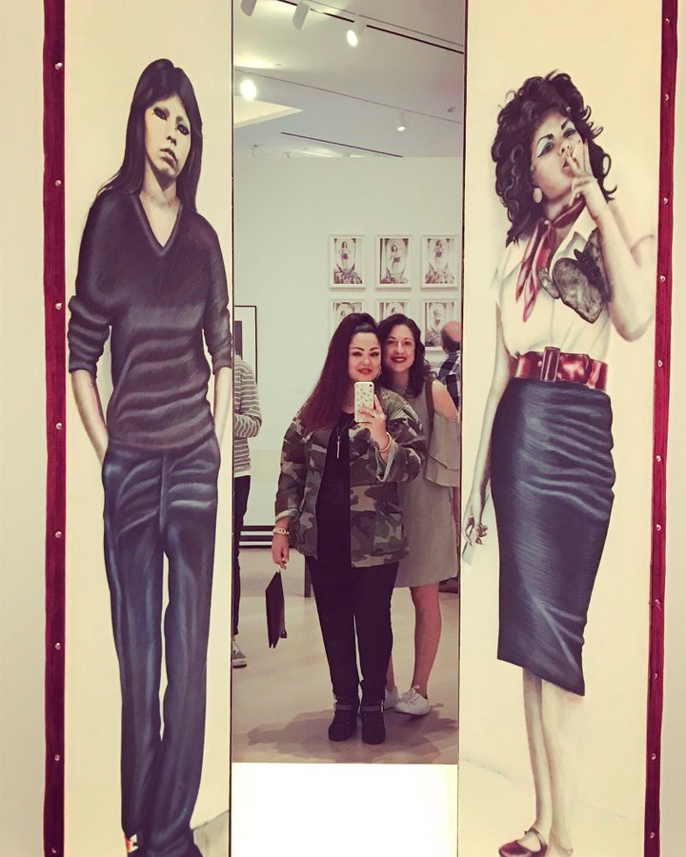
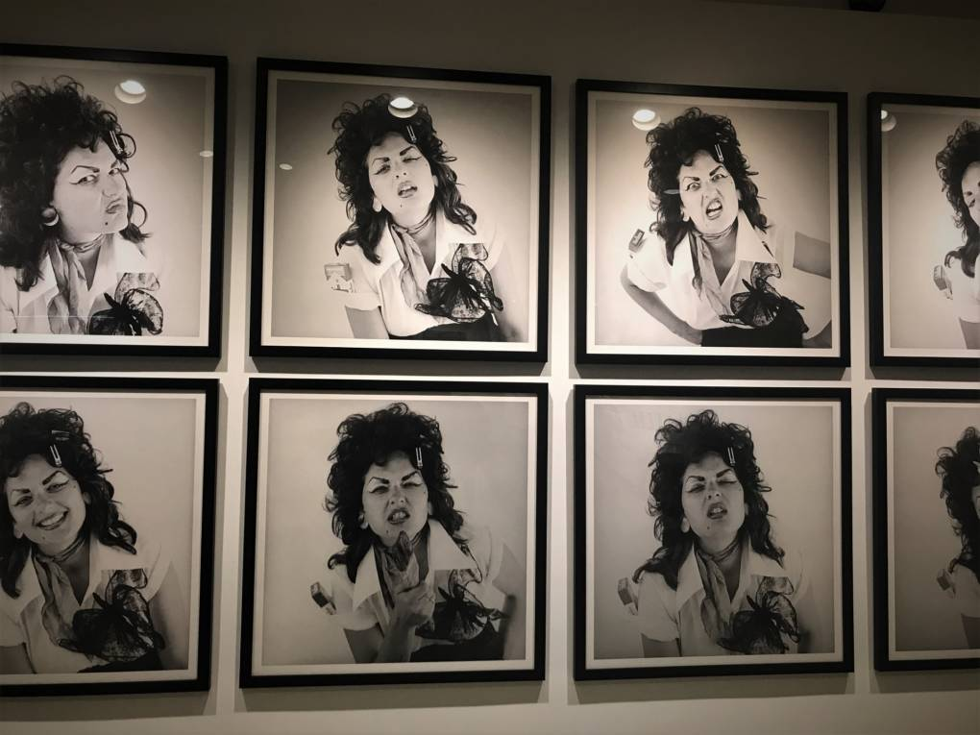
Judy Baca (US b. 1945)
(right): Las Tres Marías, 1976.
(below) Baca’s early 70's La Pachuca series
Chicanx and Feminist artists vastly expanded the creative possibilities of Pop, Conceptual, and Performance art to convey political ideas to the public beyond the Art public

Slide 3
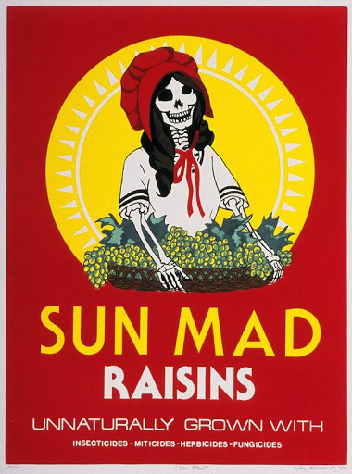
Ester Hernandez (US, b. 1944), Sun Mad Raisins, 1982 silk screen print
With this screen print, Hernández brought awareness to the injustices faced by her community. She created Sun Mad after learning that her hometown in Dinuba, California had polluted water and laborers who worked in an environment contaminated by pesticides.

Slide 4
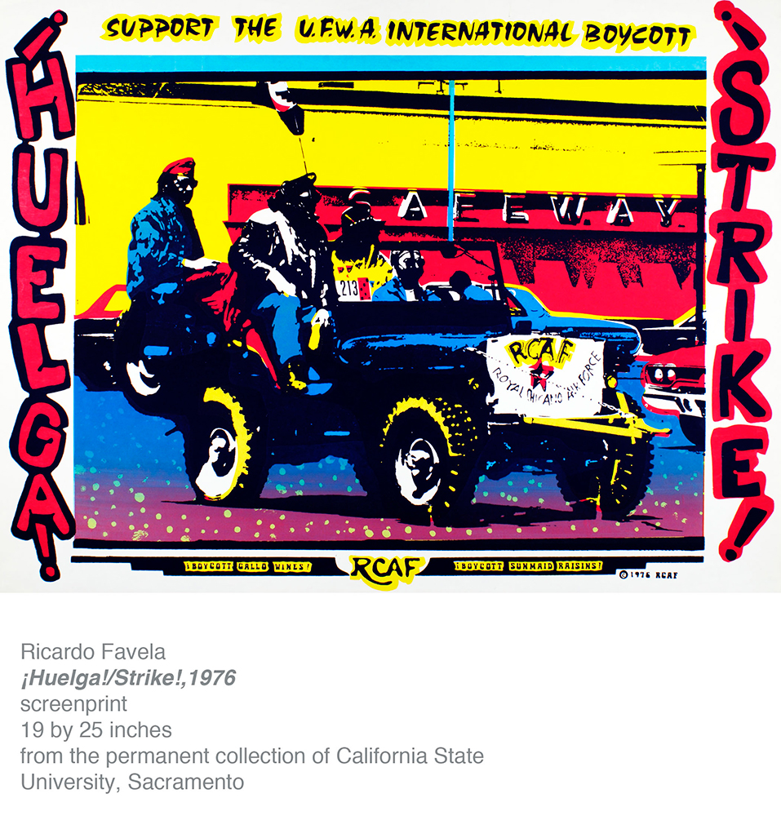

Slide 5
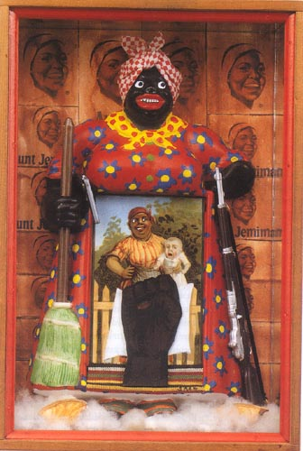
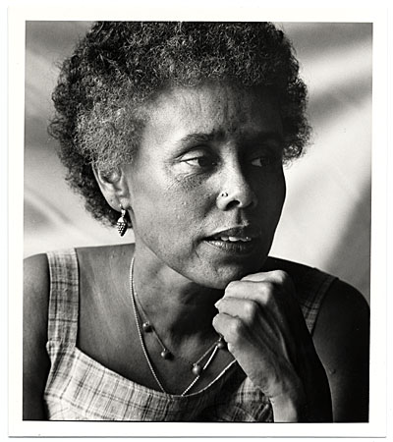
Betye Saar (b. Los Angeles, 1926)
The Liberation of Aunt Jemima mixed-media assemblage, 1972
Berkeley Art Museum collection
Betye Saar in 1979

Slide 6



Slide 7
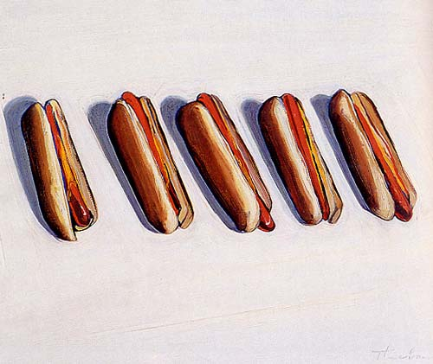
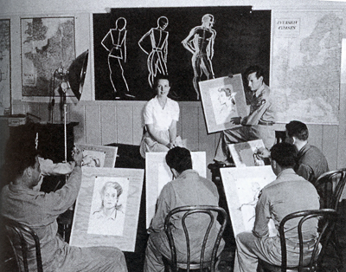
Wayne Thiebaud (US, b. 1920), Five Hot Dogs, 1961, o/c, 18 x 24 in, Whitney Museum of American Art. Pop Art.
Thiebaud served as an artist in the First Motion Picture Unit of the United States Army Air Forces from 1942 to 1945. Thiebaud earned a BA degree from Sacramento State College in 1941 an M.A. degree in 1952.

Slide 8
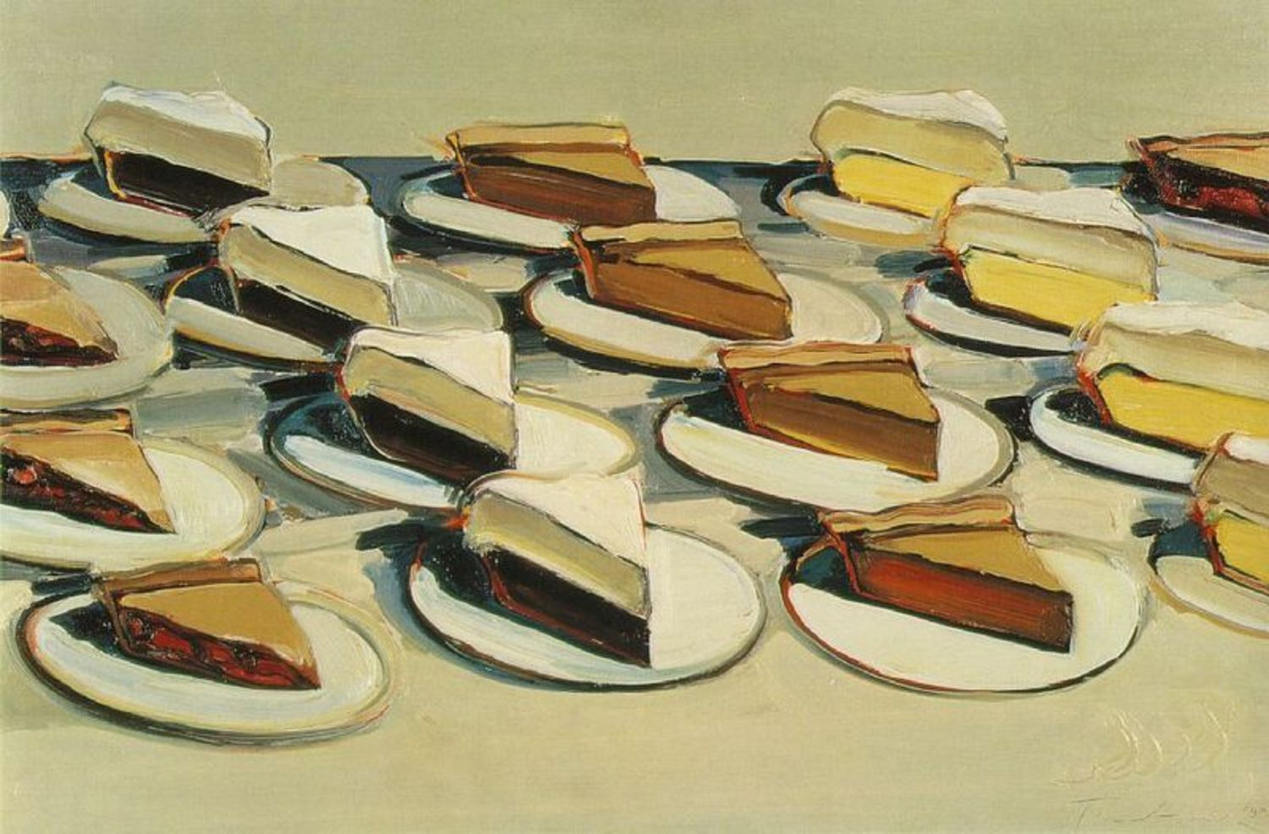
Wayne Thiebaud (US, b. 1920), Pies, Pies, Pies, oil on canvas, 1961, 20 x 30 in.
Crocker Art Museum, Sacramento. Pop Art

Slide 9
Minimalism, Conceptual Art & Post-Minimalism
“The sensuous object, resplendent with compressed internal relations has had to be rejected.”
Robert Morris
Recommended reading: Michael Fried, “Art and Objecthood” (excerpt); Sol Lewitt, “Sentences on Conceptual Art”; Martha Rosler, “Statement,” available on “Readings” page of Art 112/212 course website

Slide 10
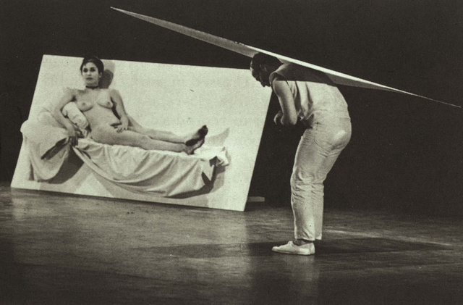
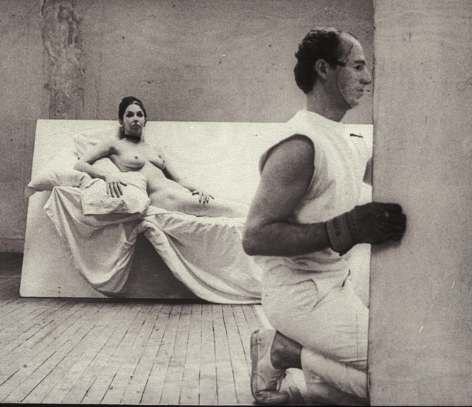
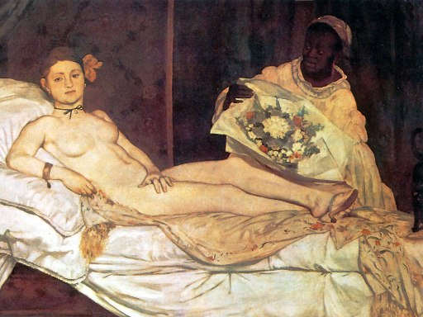
Robert Morris and Carolee Schneeman, Site, 1964, performance, New York
(compare: below, left) Edouard Manet, Olympia, 1863 (avant-garde icon)
Morris’s mask is by Jasper Johns

Slide 11
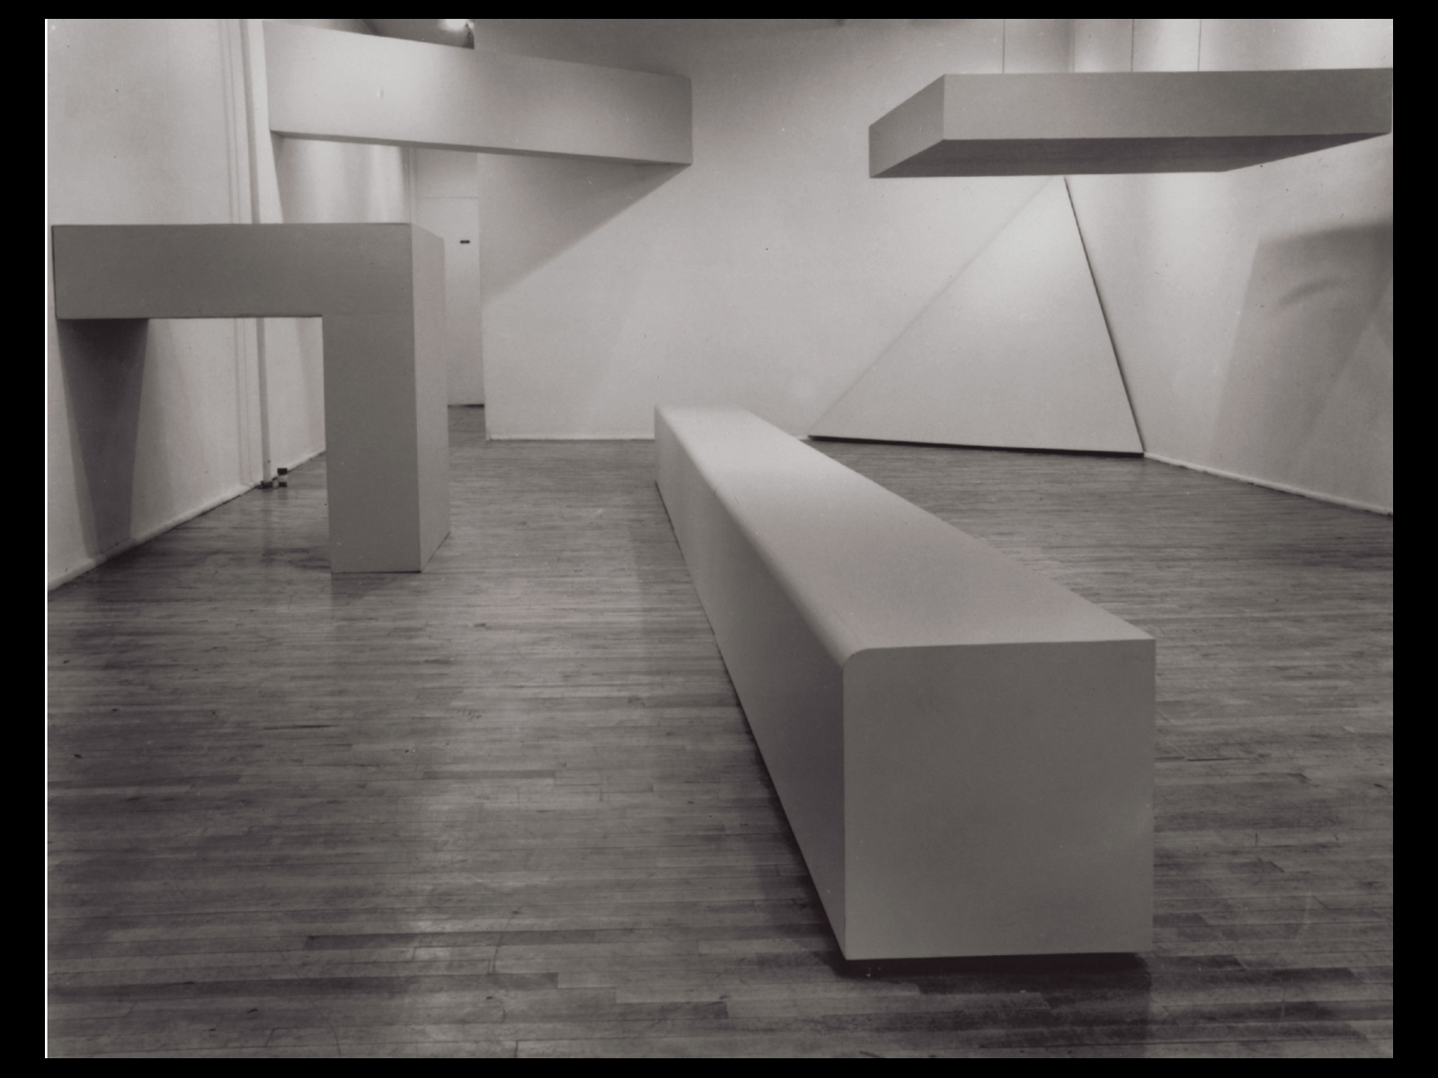
Robert Morris, Green Gallery Installation. Seven painted plywood sculptures
at the Green Gallery, New York, 1964.
Notes:
1.6 Robert Morris, Green Gallery Installation. Seven painted plywood sculptures at the Green Gallery, New York, 1964. Varying dimensions. Courtesy Leo Castelli Gallery, New York.

Slide 12
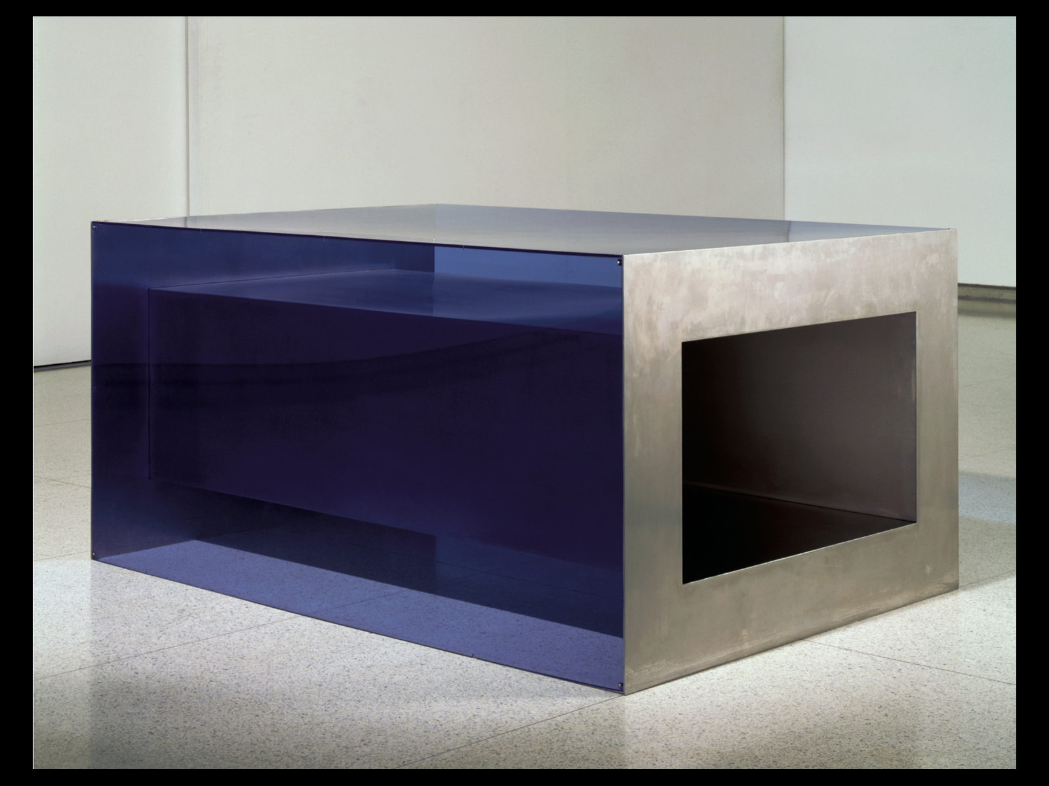
Donald Judd, Untitled, 1968, stainless steel, plexiglass, overall 33 x 68 x 48"
Notes:
1.5 Donald Judd, Untitled, 1968. Stainless steel, plexiglass, overall 33 x 67 7∕8 x 48" (83.82 x 172.4 x 121.92 cm). From the exhibition “Art in Our Time: 1950 to the Present,” Walker Art Center, Minneapolis, 5 September 1999 to 2 September 2001. Collection Walker Art Center.

Slide 13
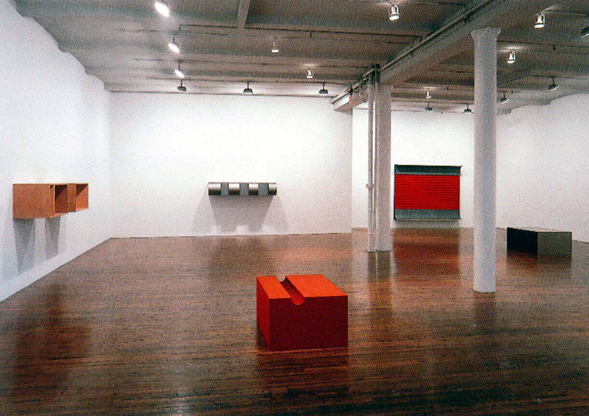
The essence of sculpture is its reliance on space: “a work can be as powerful as it can be thought to be. . . . Actual space is intrinsically more powerful and specific than paint on a flat surface… A work need only be interesting” (Donald Judd)
Theatricality and the “end” of Greenbergian modernism

Slide 14
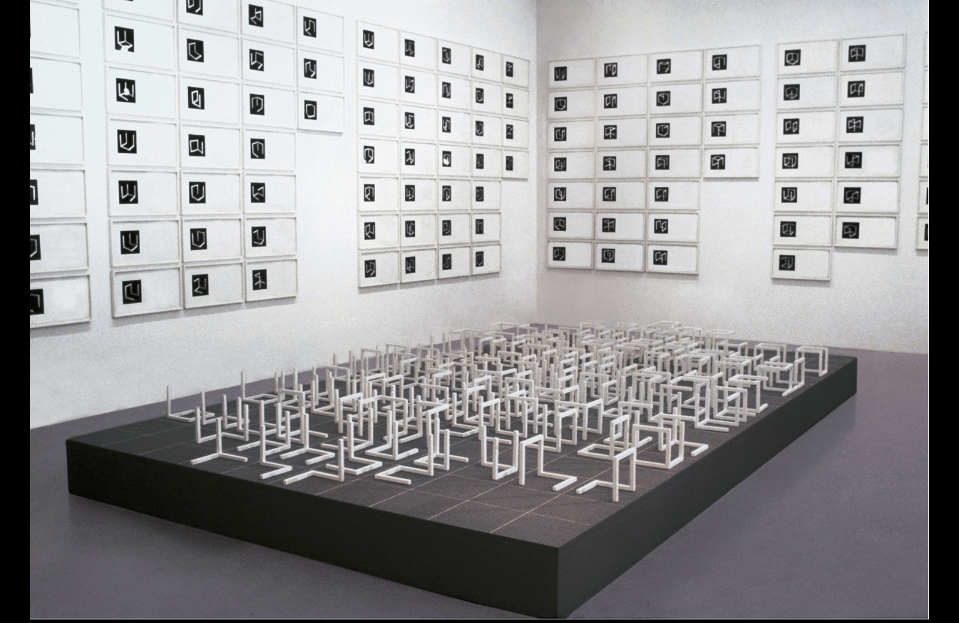
Sol LeWitt, Variations of Incomplete Open Cubes, 1974. Wood sculptures with white paint (122 pieces), each piece 8” (20.3 cm) square. Framed photographs and drawings (131 pieces), each piece 26 x 14”. Base 12 x 120 x 216"

Slide 15
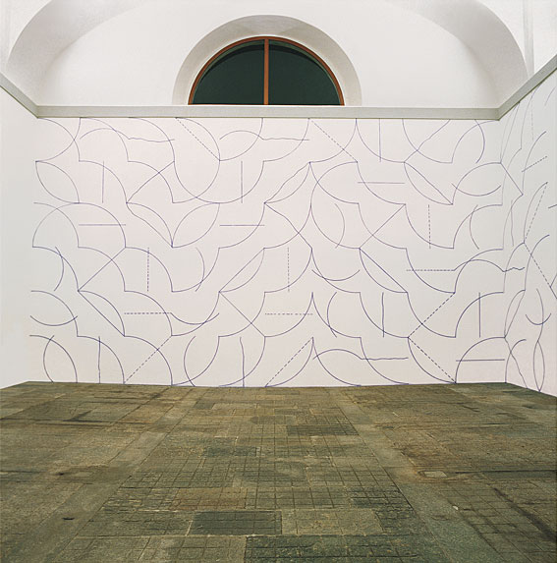
Lewitt, Wall Drawing #146, September 1972. All two-part combinations of blue arcs from corners and sides and blue straight, not straight, and broken lines; blue crayon, Dimensions vary with installation.

Slide 16
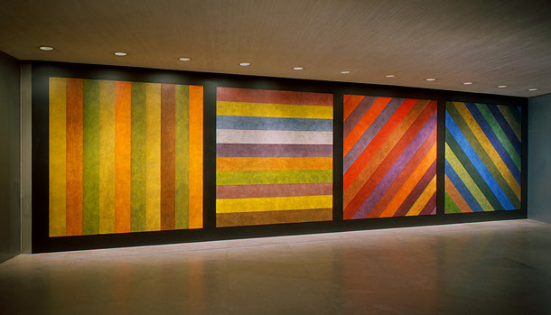
Sol LeWitt, Wall Drawing No. 681 C / A, 1993
Instructions: wall divided vertically into four equal squares separated and bordered by black bands. Within each square, bands in one of four directions, each with color ink washes superimposed, 120 x 444 in.

Slide 17
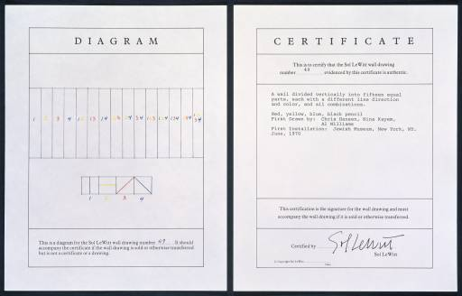
Lewitt, A Wall Divided Vertically into Fifteen Equal Parts, Each with a Different Line Direction and Color, and All Combinations 1970
"In conceptual art the idea or concept is the most important aspect of the work . . . all planning and decisions are made beforehand and the execution is a perfunctory affair. The idea becomes the machine that makes the art."
Sol LeWitt: "Paragraphs on Conceptual Art," Artforum, summer issue, 1967

Slide 18
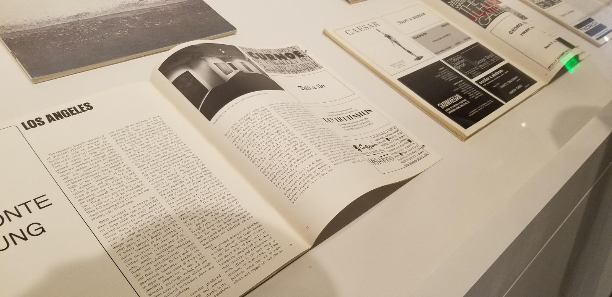
Steve Kaltenbach, Tell a Lie, Art Forum magazine “ad” intervention, 1969. Photo by Miranda Zirbel

Slide 19
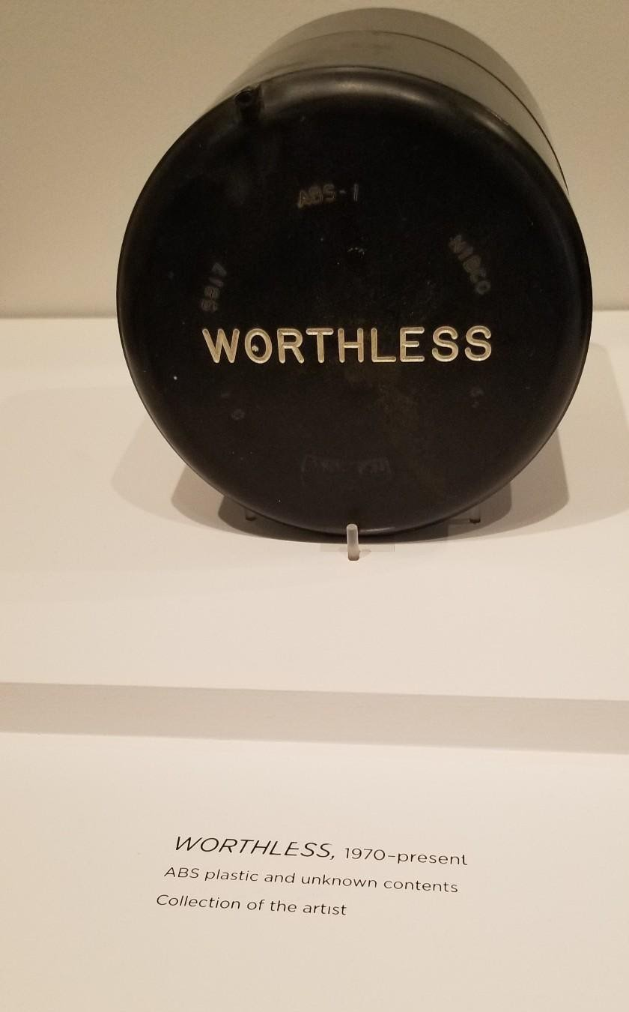
Steve Kaltenbach

Slide 20
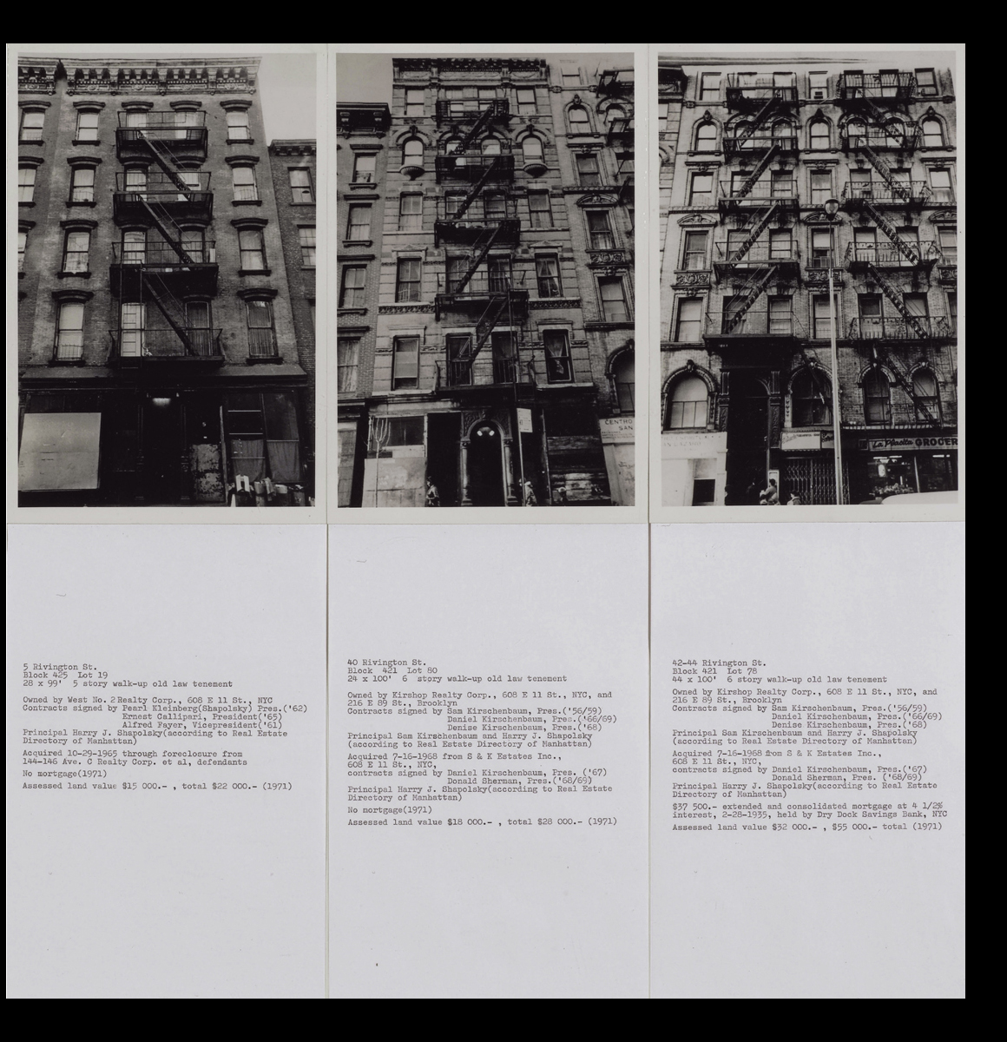
Hans Haacke, Shapolsky et al., Manhattan Real Estate Holdings, a Real-Time Social System, as of May 1, 1971, 1971.
Showing three of 33 panels; 146 black and white photographs, 146 typewritten pages, 2 plans, 6 tables of transactions, 1 explanatory panel. La Musée National d'Art Moderne, Centre Georges Pompidou, Paris.
Notes:
1.18 Hans Haacke, Shapolsky et al., Manhattan Real Estate Holdings, a Real-Time Social System, as of May 1, 1971, 1971. Showing three of 33 panels; 146 black and white photographs, 146 typewritten pages, 2 plans, 6 tables of transactions, 1 explanatory panel. La Musée National d'Art Moderne, Centre Georges Pompidou, Paris.

Slide 21
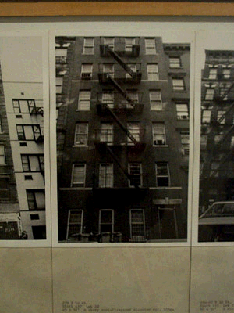
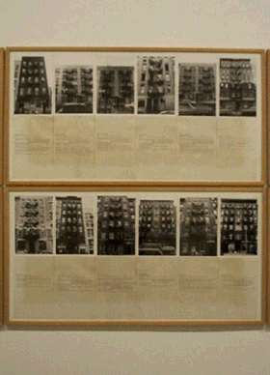
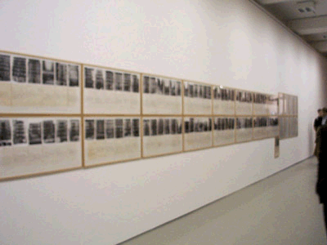
Hans Haacke (German, b.1936), Shapolsky et al. Manhattan Real Estate Holdings, a Real-Time System, as of May 1, 1971, 1971: 142 photographs of New York apartment buildings, 2 maps of New York's Lower East Side and Harlem with properties marked, 6 charts documenting business relations within the real estate group.

Slide 22
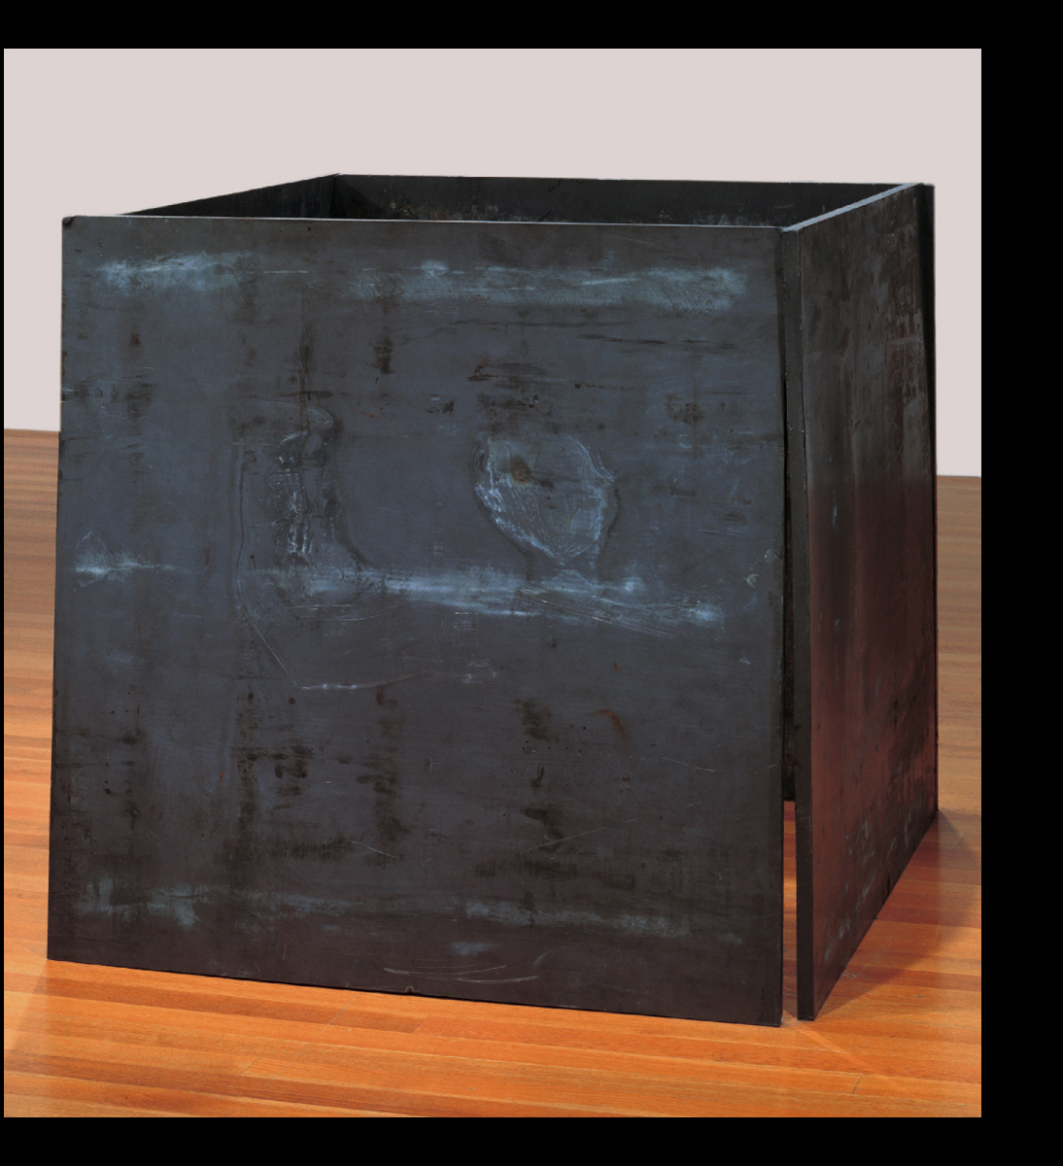
Richard Serra, Prop, 1968. Lead antimony, four plates, each 48 x 48 x 1“. The Museum of Modern Art, New York.
Post-Minimalism
Notes:
1.11 Richard Serra, Prop, 1968. Lead antimony, four plates, each 48 x 48 x 1" (122 x 122 x 2.5 cm). The Museum of Modern Art, New York. Gift of the Grinstein Family. Acc. num. 286.1986.a-d.

Slide 23
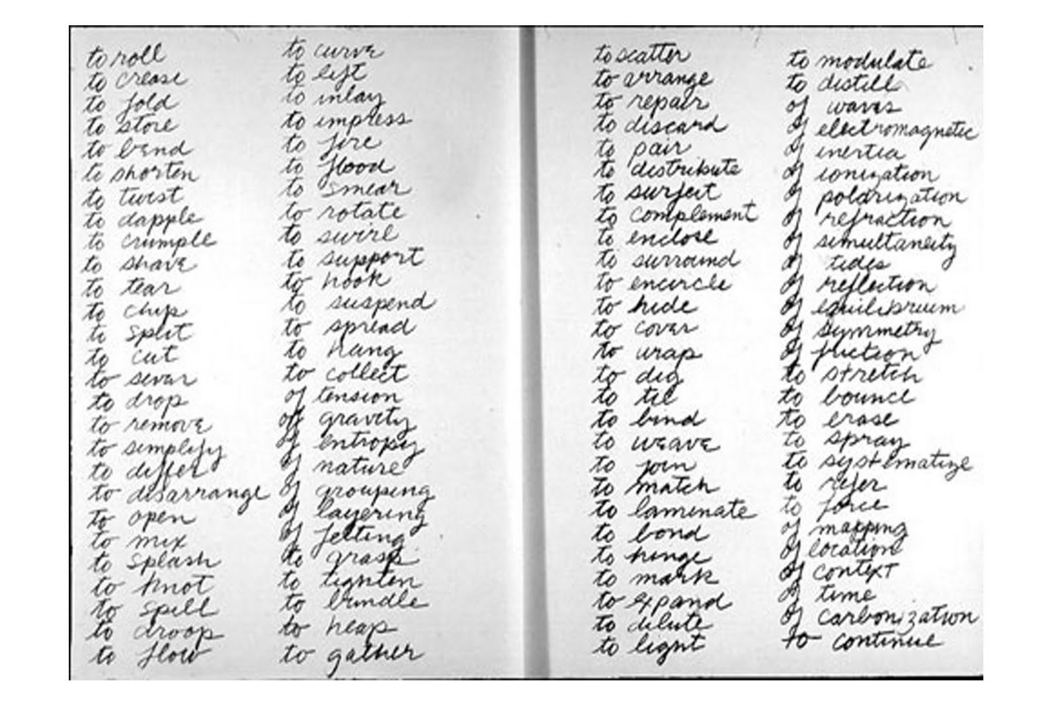
Richard Serra, Verb List, pencil on two sheets of paper, 1962-8, “Drawing is a verb… [the list is] a series of actions to relate to oneself, material, place, and process.” Serra listed the infinitives of 84 verbs and 24 possible contexts – of gravity, of entropy, of nature, etc. – in four columns of script.

Slide 24
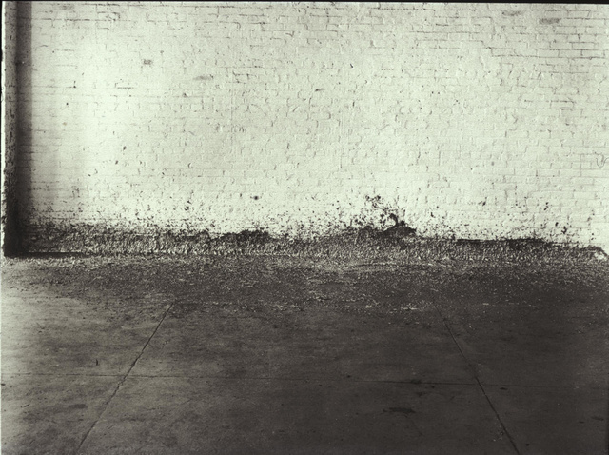
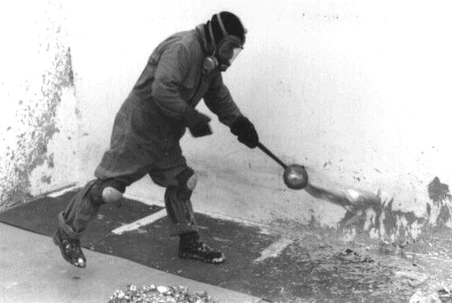
Richard Serra (b. 1939, US), Splashing, 1968, molten lead left to harden,
Leo Castelli warehouse. Action / Process Sculpture

Slide 25
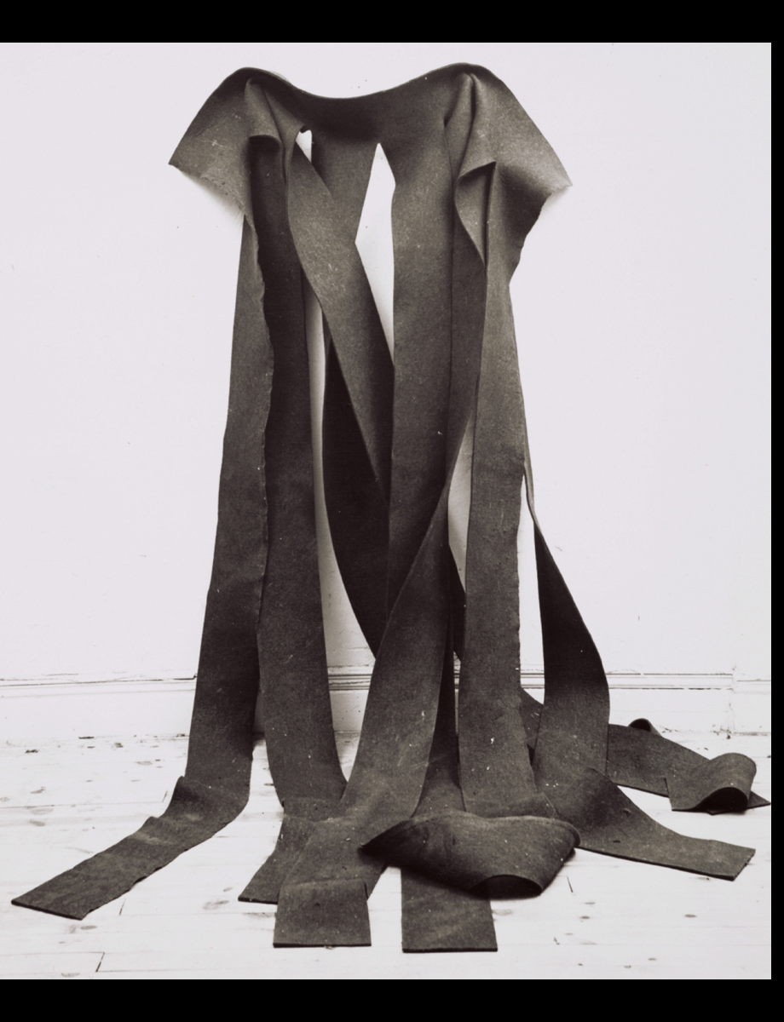
Robert Morris, Untitled, 1967. Felt, 12 x 6' (3.65 m x 182.88 cm). Archives of American Art, Smithsonian Institution
Post-Minimalism, process art employing chance and gravity
Notes:
1.10 Robert Morris, Untitled, 1967. Felt, 12 x 6' (3.65 m x 182.88 cm). Archives of American Art, Smithsonian Institution. Collection of Ellen Johnson. Photo Rudy Burckhardt.

Slide 26
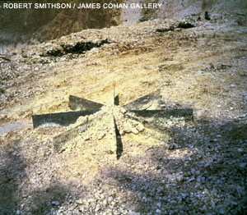
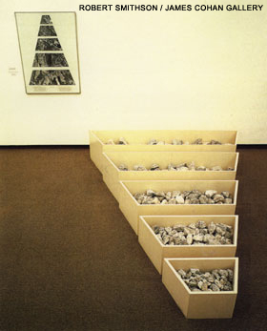
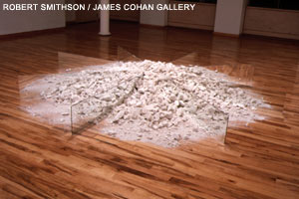
Robert Smithson (US, 1938-1973), A Nonsite: Franklin, New Jersey, summer, 1968 wood, limestone, aerial photographs, 16 1/2" x 82" x 110“
(right top and bottom) Chalk and Mirror Displacement, 1969, 6 mirrors / chalk from quarry in Oxted, England, each 10"x 5" (overall 10‘)

Slide 27
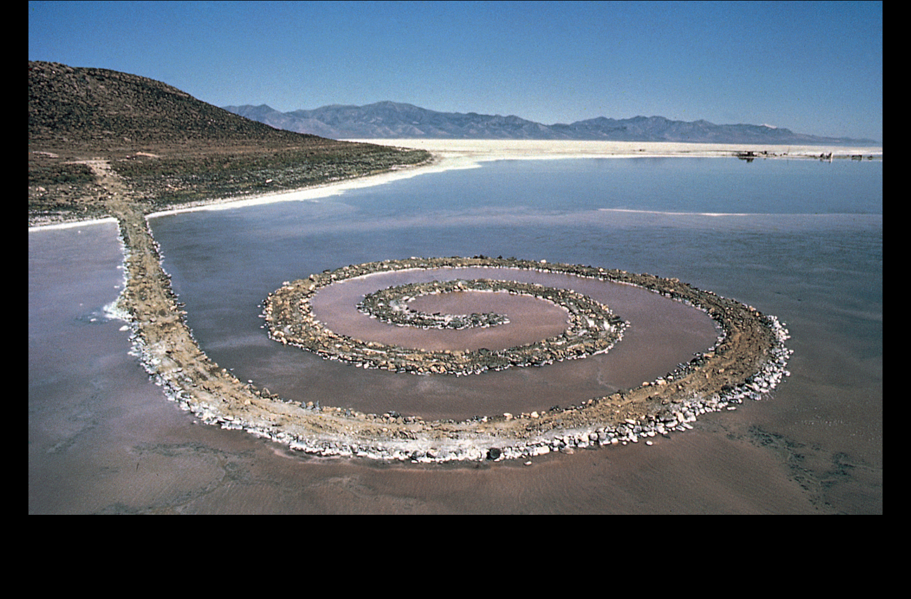
Robert Smithson, Spiral Jetty, 1970. Black basalt, limestone rocks, earth, and salt crystals, length 1,500’ (457.2 m). Great Salt Lake, Utah.
Notes:
1.12 Robert Smithson, Spiral Jetty, 1970. Black basalt, limestone rocks, earth, and salt crystals, length 1,500’ (457.2 m). Great Salt Lake, Utah. Photograph by Gianfranco Gorgoni, courtesy John Weber Gallery, New York.

Slide 28
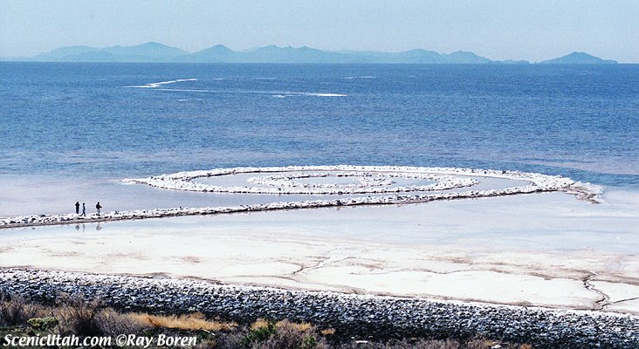
Robert Smithson (US, 1938-1973) Spiral Jetty, 1970, Great Salt Lake, black rocks, salt crystals, Dia foundation collection

Slide 29
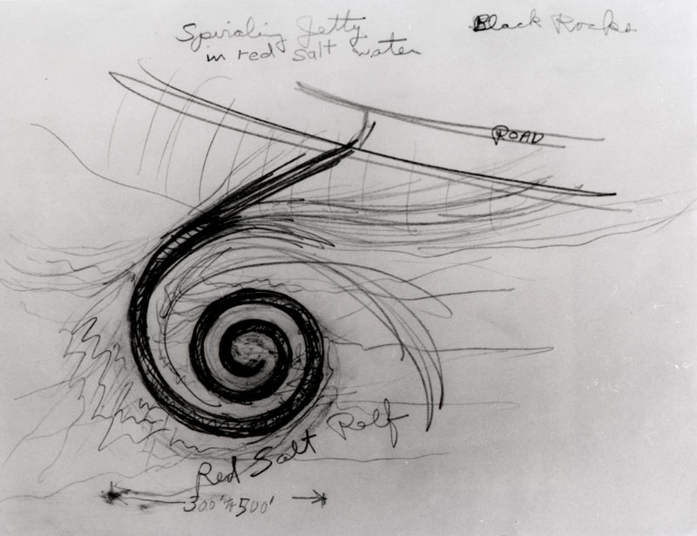
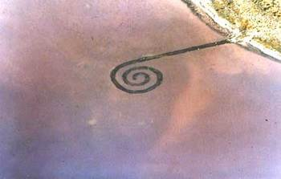
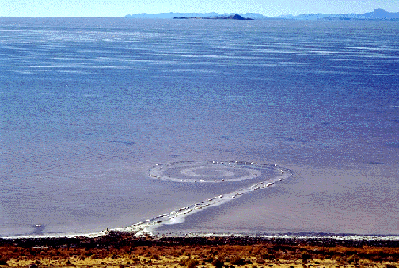

Slide 30
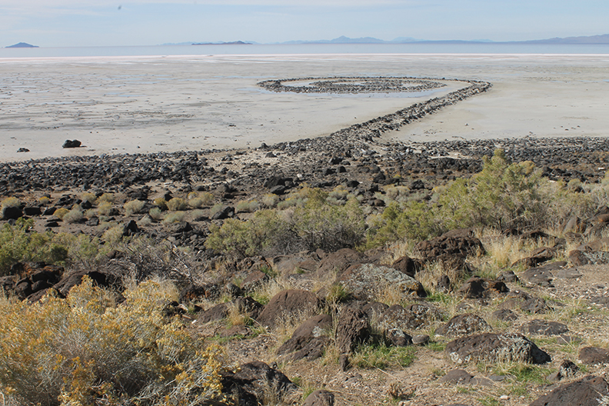
Summer 2015
photo by Danny Cardenas
Go to Google Earth for location and current condition (dry) of the lake

Slide 31
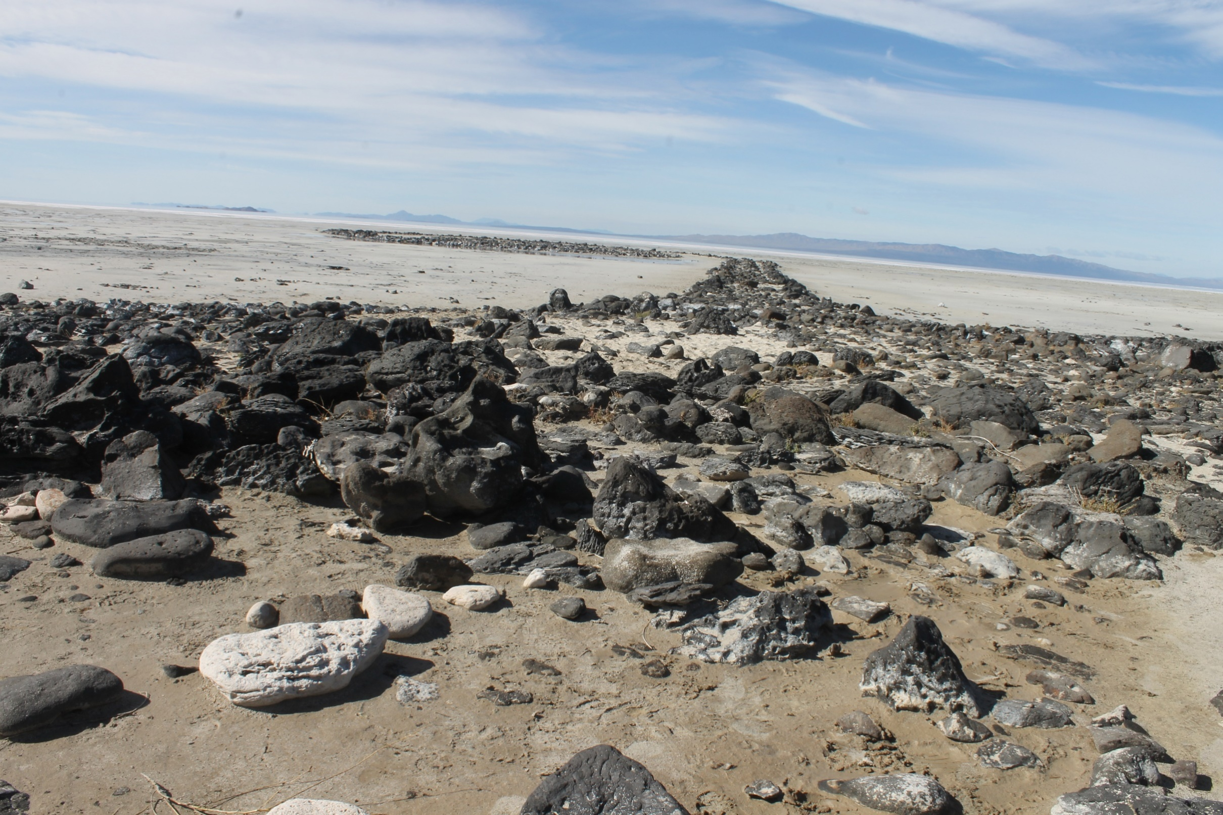
Summer 2015
photo by Danny Cardenas

Slide 32
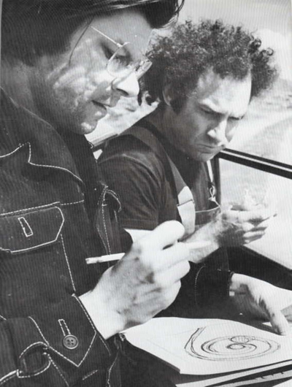
Robert Smithson (left) and Donald Judd (right) at site of Spiral Jetty, 1970
Minimalism – Post-Minimalism

Slide 33
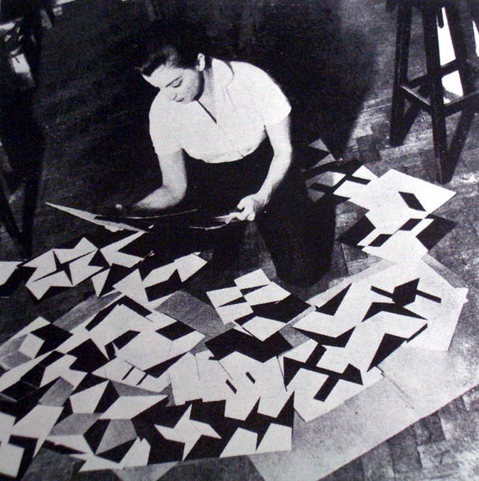
Lygia Clark (Brazil, 1920-1988) Rio de Janeiro 1958

Slide 34
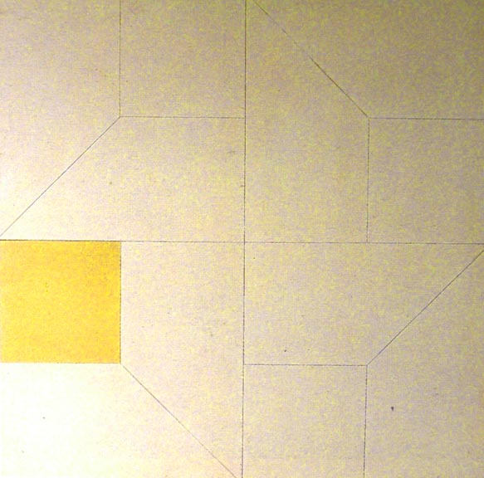
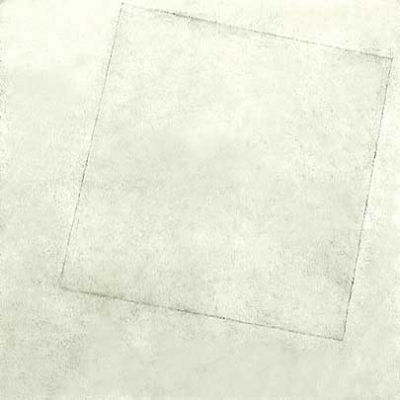
(left) Lygia Clark, Relief Painting with Yellow Square, oil, 1957, 30 in. H
Brazilian Neoconcretism
(right) compare: Kasimir Malevich, Suprematism, White on White, 1918

Slide 35
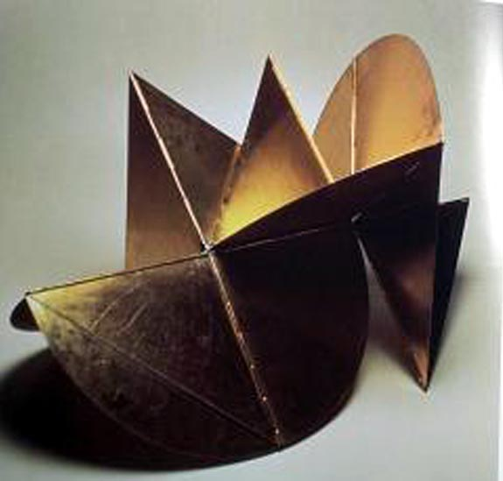
Lygia Clark, Machine Animal (Bicho), 1962, aluminum, 55x65, Sao Paulo

Slide 36
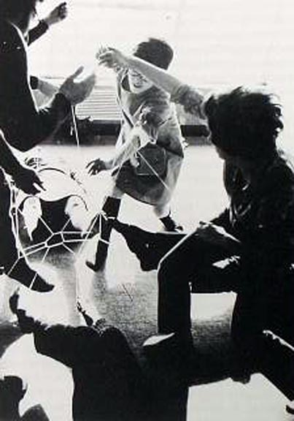
Lygia Clark, Mandala, from the series, Collective Body, 1959, elastic bands linking people at their wrists or ankles

Slide 37
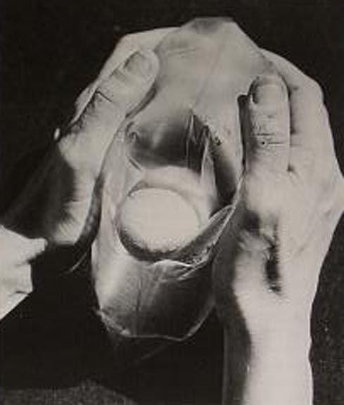
Lygia Clark, Air & Stone (Multiple) 1966, inflated plastic bag and stone

Slide 38
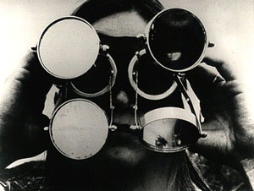
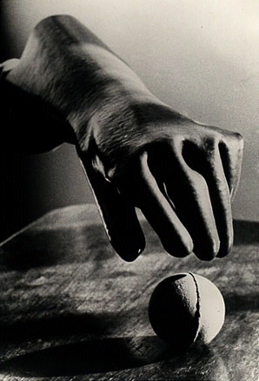

(left) Lygia Clark, Mask with Mirrors, 1967; (below) Dialogue, 1968
The mask holds small movable mirrors in front of the eyes, juxtaposing and fracturing reflections of the self and the surrounding world.
(right) Clark, Sensorial Gloves, 1968. Part of Nostalgia of the Body series.
Gloves are made of various materials, sizes and textures. Participants use the many combinations of gloves and balls of different sizes, textures and weights, and then hold the balls again with bare hands. Purpose is to rediscover keen sensation.

Slide 39

Lygia Clark and Helio Oiticica, Dialogue for Hands, 1966 elastic Möbius band
Elastic Möbius band
“Helio and I are like a glove. He is the outside of the glove, very much linked to the exterior world. I am the inside. And the two of us exist from the moment there is a hand which puts on the glove” (Lygia Clark ) http://www.cut-the-knot.org/do_you_know/moebius.avi

Slide 40


(left) Hélio Oiticica (Brazil, 1937-1980), White Crossing Red – Metaschema
1968, oil, 21 in. H; compare Piet Mondrian, Tableau, 1921, Neoplasticism

Slide 41


(left) Hélio Oiticica, Spatial Relief, 1959, synthetic polymer paint on wood, 38 x 48 x 8”
(right) Alexander Rodchenko, Spatial Relief, 1920, Russian Constructivism

Slide 42

Hélio Oiticica, B3 Bólide Box 3 “Africana,” 1963. Oil on wood, 23 5∕8 x 9 3∕8 x 11 3∕4" (59.9 x 23.8 x 30 cm). Image courtesy Projecto Hélio Oiticica.
Notes:
1.7 Hélio Oiticica, B3 Bólide Box 3 “Africana,” 1963. Oil on wood, 23 5∕8 x 9 3∕8 x 11 3∕4" (59.9 x 23.8 x 30 cm). Image courtesy Projecto Hélio Oiticica.

